Slide 1
Deepfake and Real Images
Kai-Wen Lai,

Slide 2
Table for summary statistics
 | Description | Mean | Standard Deviation | Median | (min,max) | Sample Size
Y | Fake image(0) Real image(1) | 0.496 | 0.5 | 0 | (0,1) | 10905
We may need to normalize the input data. This is because each input image may have a different size. Furthermore, normalizing the input data can also help the model achieve higher prediction accuracy.
Normalization can make all the input features have the same scale and distribution, thereby improving the model's learning efficiency and generalization ability.

Slide 3
Outcome variable
Using
Image
Split
data
The outcome variable we have is binary variable.
Deepfake images (0)
Real images (1)
Yes, we are using the image of human face either real or fake.
Training set: 6979
Validation set: 1745
Testing set: 2181

Slide 4
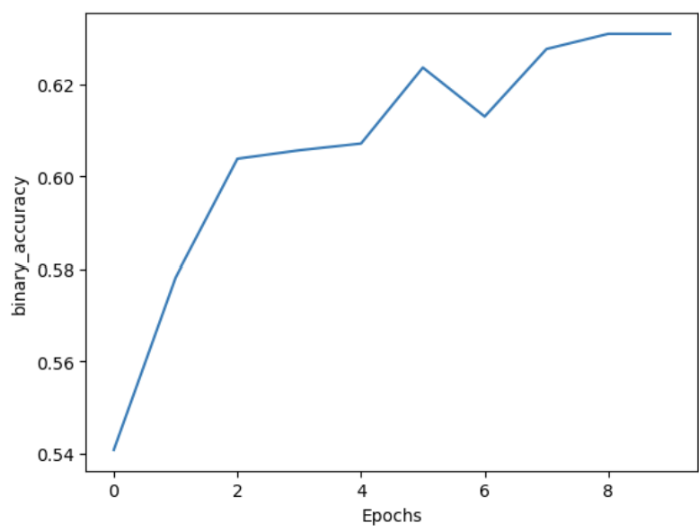
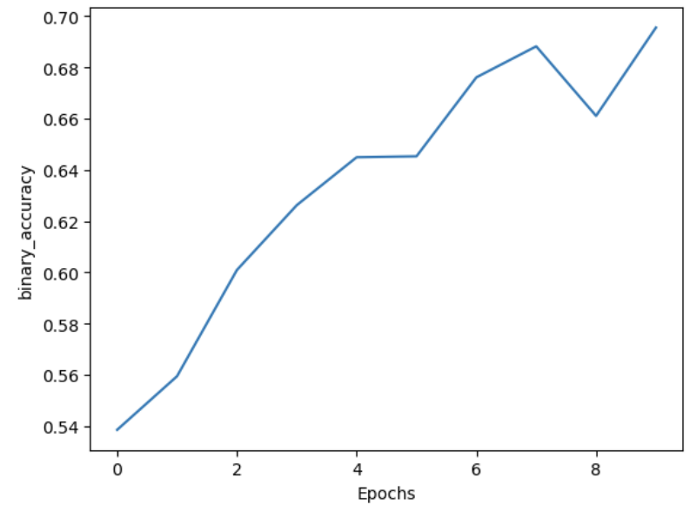
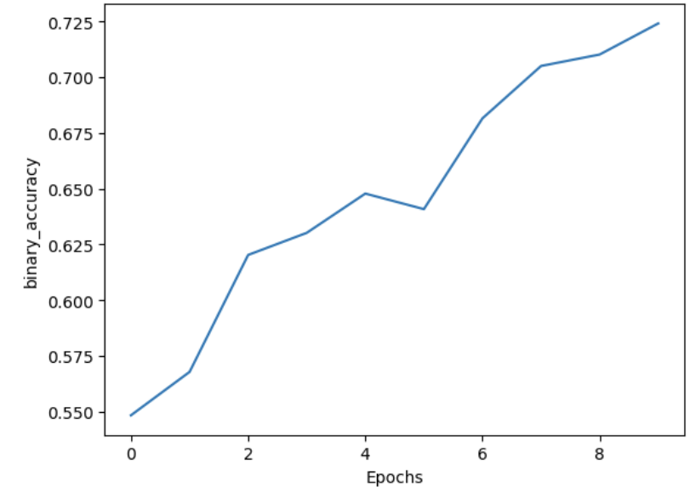
The metric(s) we using to evaluate training performance
Training accuracy
Logistic regression model
Training accuracy after 10 epoches is about 63%
Bigger neural network
Training accuracy of increase hidden units is 73%
Our training accuracy after 10 epochs is about 70%, which is better than human's random guess (50%).
Notes:
We use training accuracy to evaluate our training dataset. Since in this dataset, predicting the
image is a deepfake or real image, false positive and false negative are equally important.
We care about the TP, TN, FP, FN, so we use training accuracy here.

Slide 5
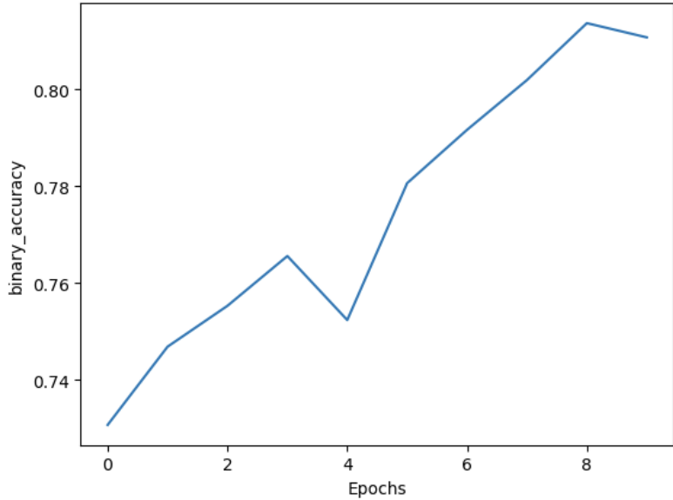
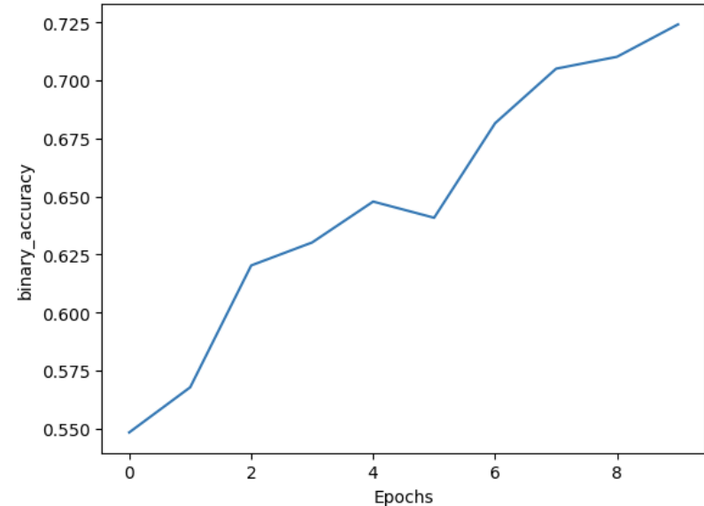
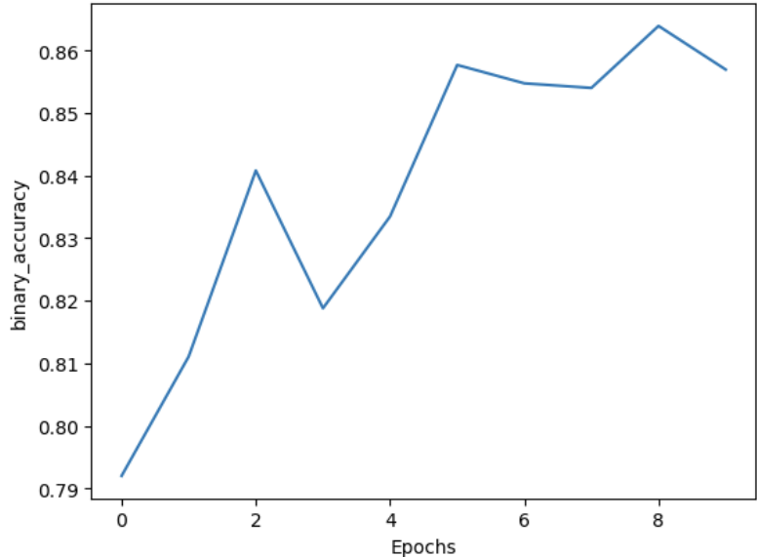
e. Using a better optimization algorithm
Optimization Algorithm | Training Accuracy
Adam | 81 %
Nadam | 73 %
Rmsprop | 85 %
Adam
Nadam
Rmsprop

Slide 6
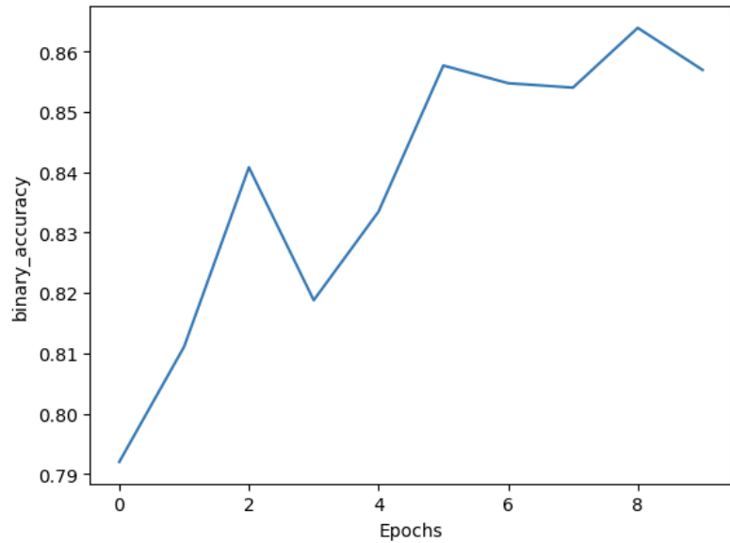
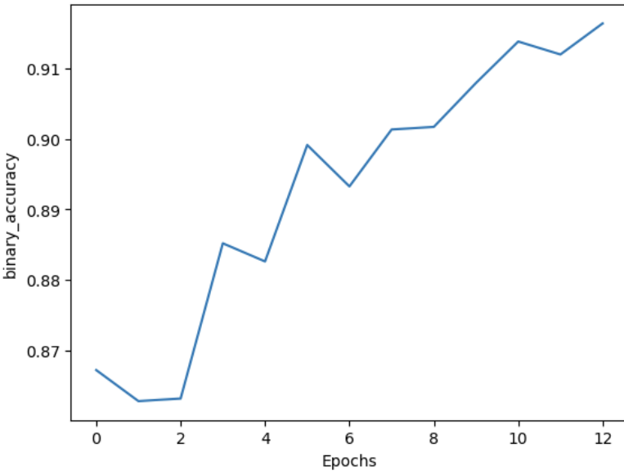
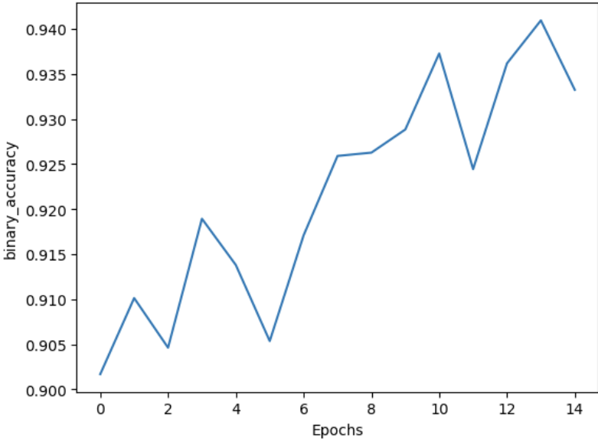
F. Report a table in which you show the training performance for at least three different epochs.
Epoches | 10 | 13 | 15
Training accuracy | 85% | 92% | 92.7%
Epoches = 10
Epoches = 13
Epoches = 15

Slide 7
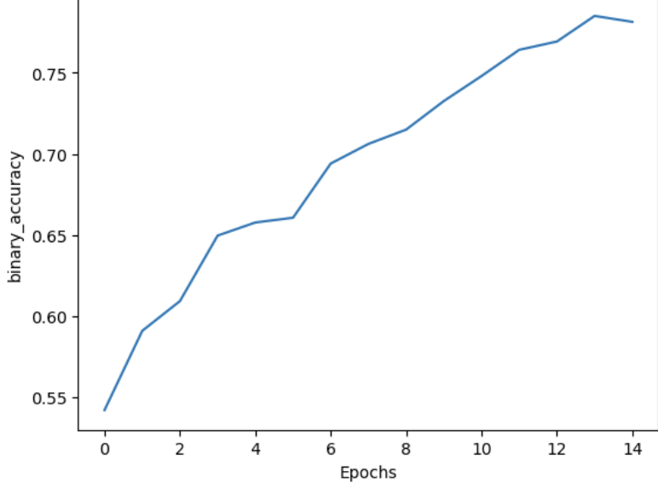
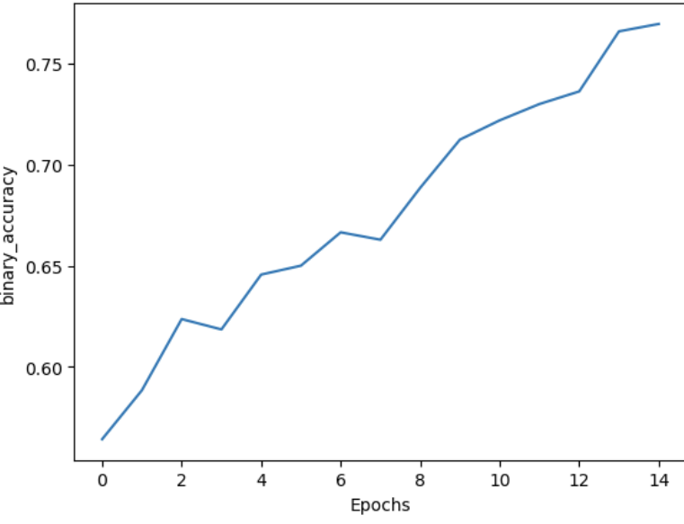
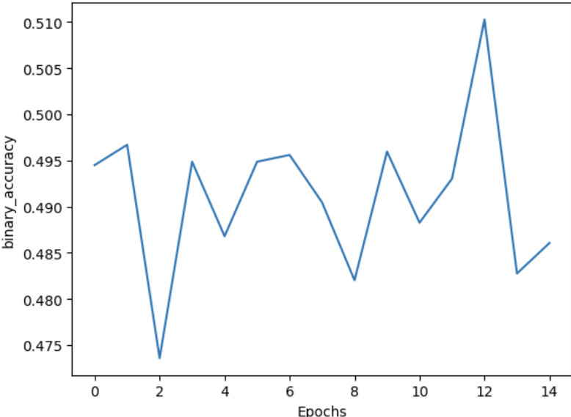
G Report a table in which you show the training performance for at least three different weight initializations.
kernel_initializer | random_unifrom | he_uniform | zeros
Training Accuracy | 78% | 77% | 49%
random_unifrom
he_unifrom
zeros

Slide 8
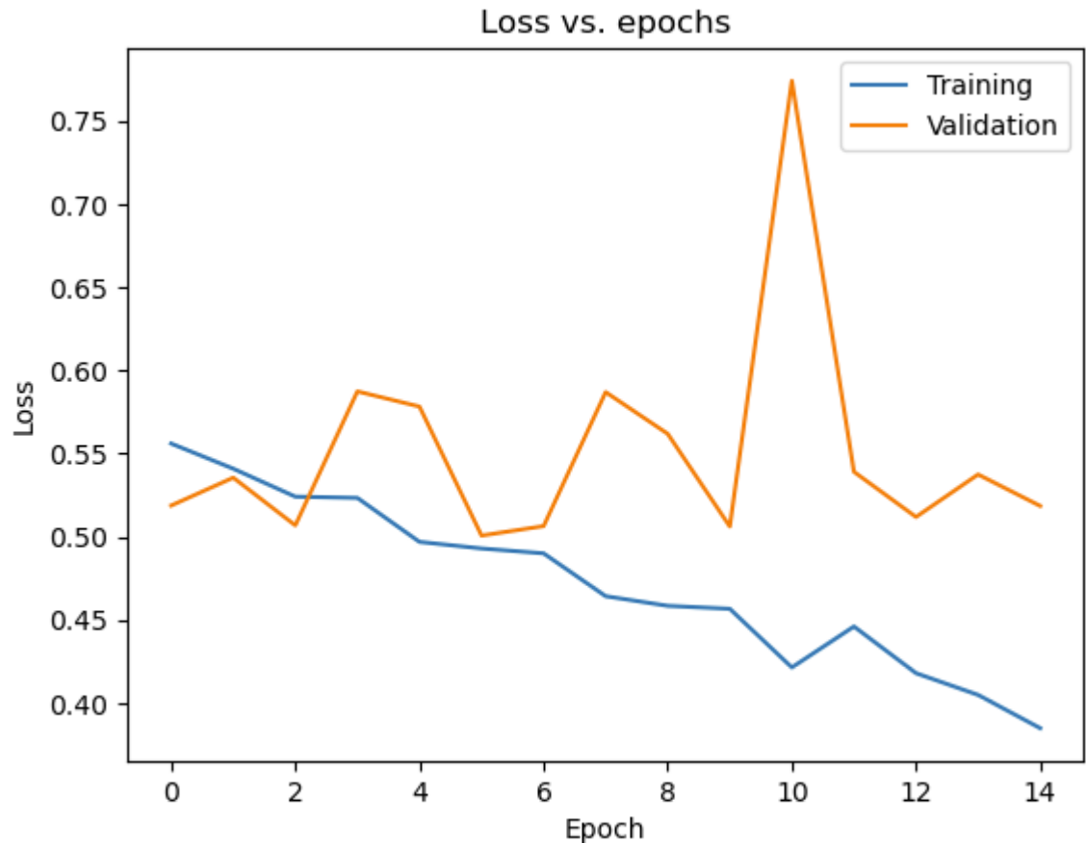
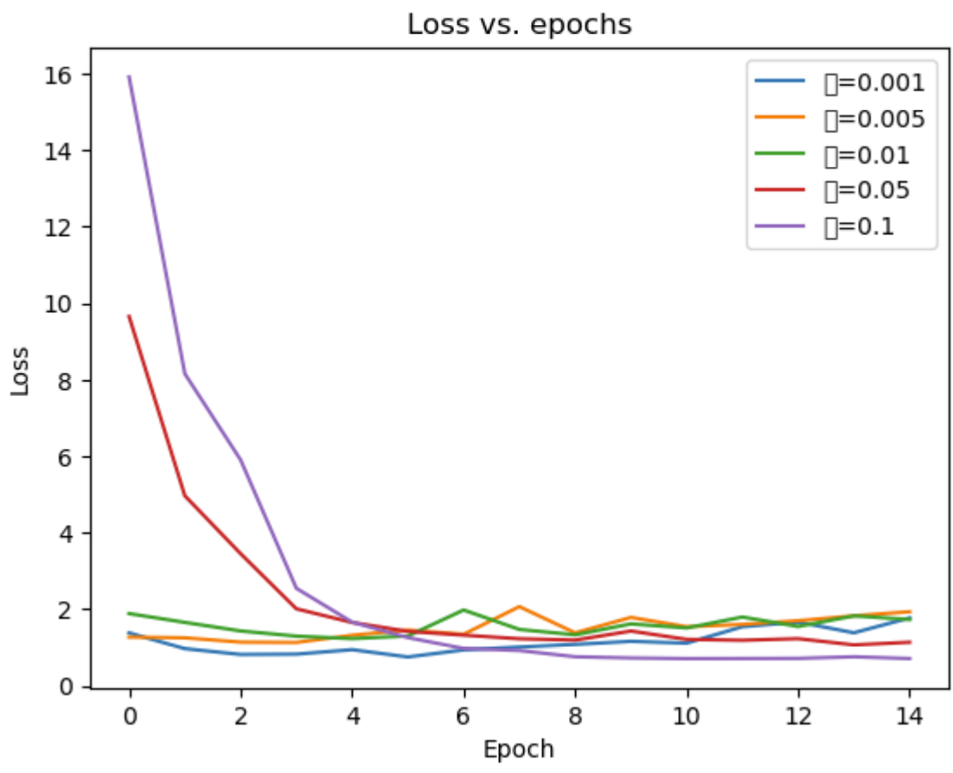
Explain which model is the best model fitting your training set?
The best model is model 4, but we have an overfitting problem for the model, as our training loss is getting lower while our validation loss is not.
Using L2 regularization
Using L2 regularization
(λ)
0.001
0.005
0.01
0.05
0.1

Slide 9
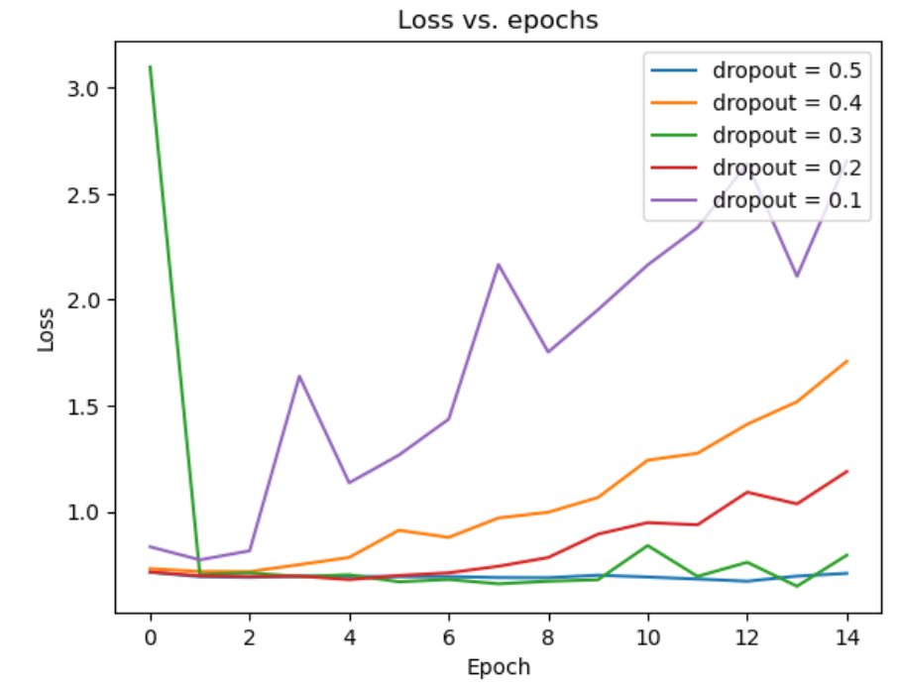
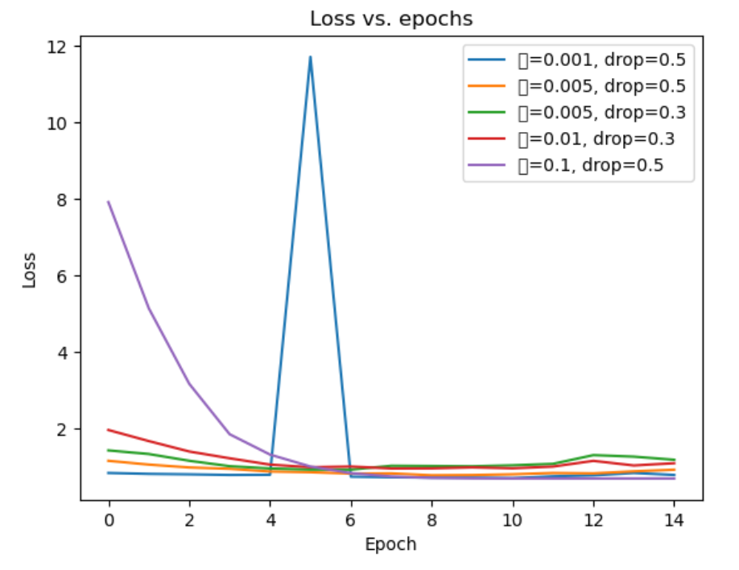
Improve validation performance
Using a mixture of dropout regularization and L2 regularization
Using dropout regularization

Slide 10
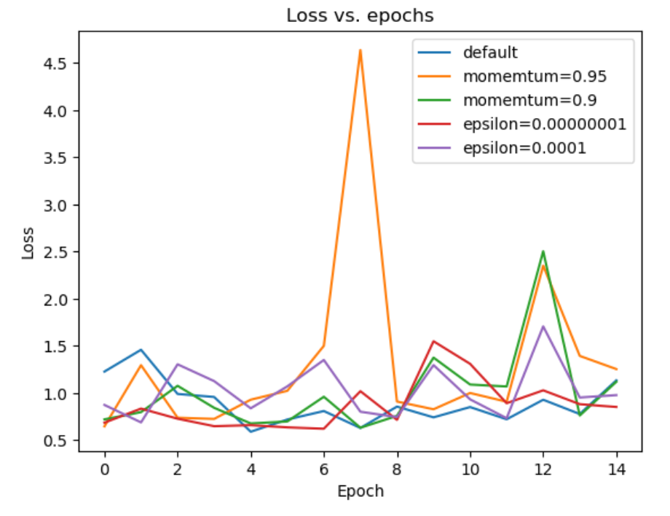
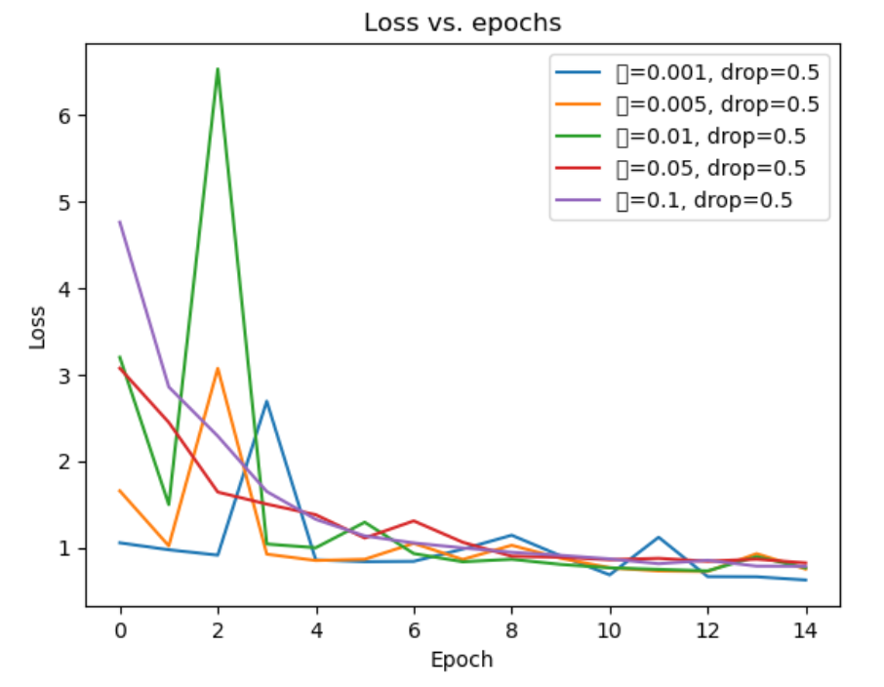
Improve validation performance
Using a mixture of batch-normalization, dropout regularization, and L2 regularization
Using batch-normalization

Slide 11
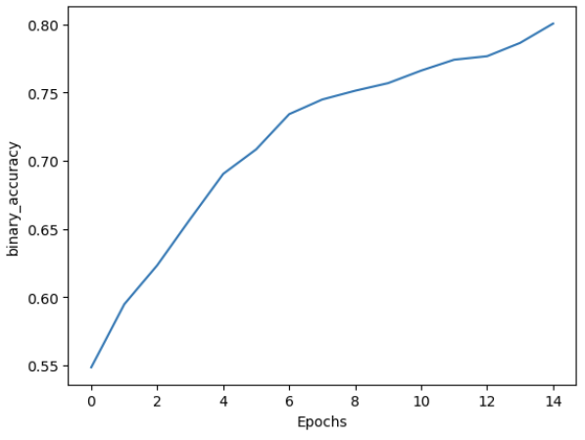
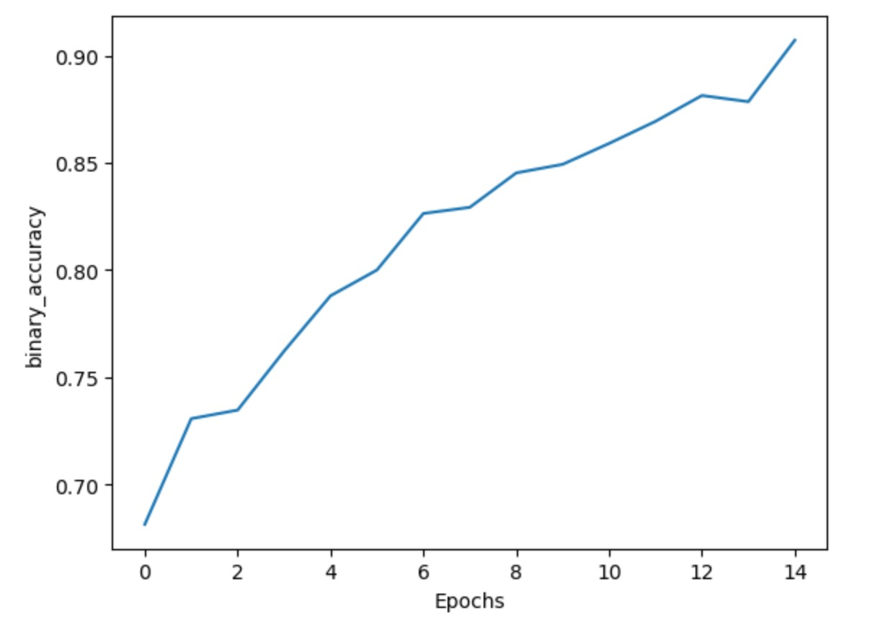
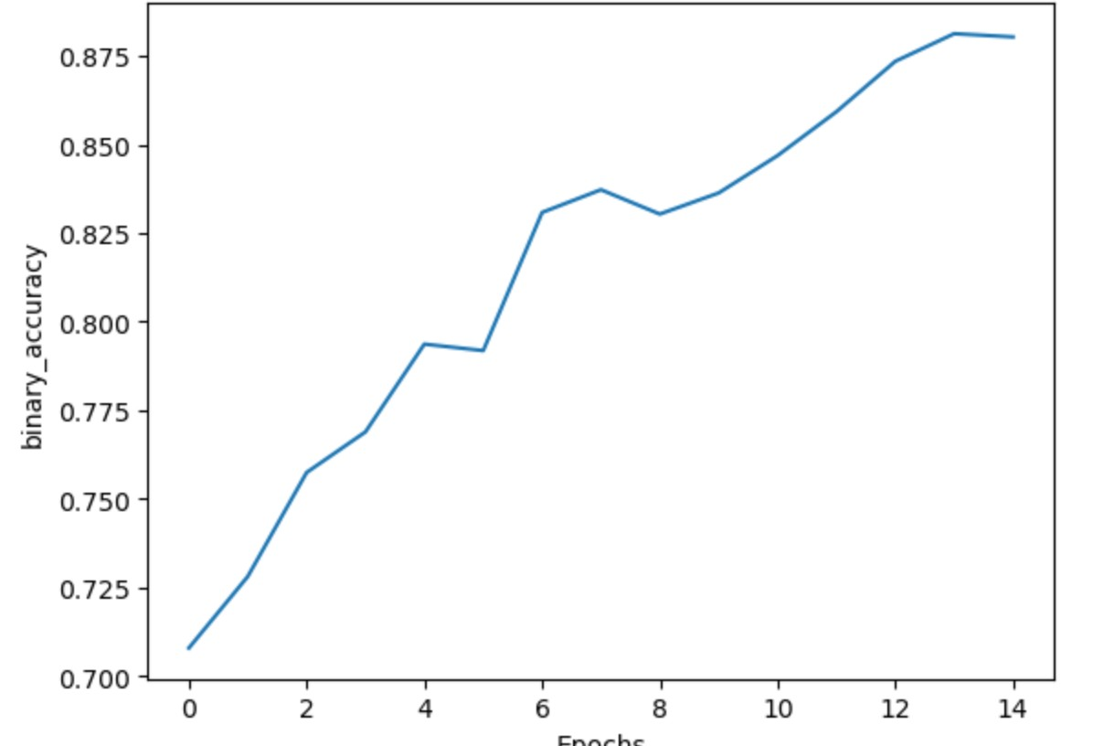
04 Find the best model
Batch normalization + dropout 0.5
Training performance
Validation performance
Test performance

Slide 12

Business implications:
Ensuring that the company can maintain high standards of security and trust when it expands its operations.
Business can save millions by preventing fraudulent transactions through automated image verification.
Automated deepfake detection can streamline content verification, enabling quicker publishing and reducing the workload on editorial teams.
Notes:
1. When the company is growing, the ability to scale its verification processes without proportional increases in cost or time is crucial. This ensures that the company can maintain high standards of security and trust as it expands its operations.
2. Cost savings come from reduced labor costs, fewer instances of fraud-related losses, and lower operational expenses. For example, a financial institution can save millions by preventing fraudulent transactions through automated image verification.
3. This rapid processing capability saves significant amounts of time, allowing companies to allocate human resources to more strategic tasks. For instance, in media companies, automated deepfake detection can streamline content verification, enabling quicker publishing and reducing the workload on editorial teams.

Slide 13
Thank You !

